Slide 1
AI- POWERED CUSTOMER SUPPORT TICKET PRIORITIZATION SYSTEM USING MACHINE LEARNING
Student name Reg no :
SARU HASINI.S (192521418)
Faculty:
DR.ROSELYN SHAKILA

Slide 2
INTRODUCTION
IT companies receive thousands of support tickets daily.
Manual ticket sorting is slow and error-prone.
Critical issues may be delayed.
AI can automatically prioritize tickets.
Faster support improves customer satisfaction.

Slide 3
OBJECTIVES
Understand the problem.
Learn the proposed AI solution.
Explain the system architecture.
Discuss project benefits.
Review the conclusion.

Slide 4
MODULE – 1 ( PROBLEM STATEMENT)
Large number of customer support tickets.
Manual prioritization takes time.
Urgent issues may be missed.
Delayed responses reduce customer satisfaction.
AI helps automate ticket prioritization.

Slide 5
MODULE – 2 (METHODOLOGY)
Collect customer support tickets.
Clean and preprocess text data.
Extract important keywords/features.
Train a Machine Learning model.
Predict High, Medium, or Low priority

Slide 6
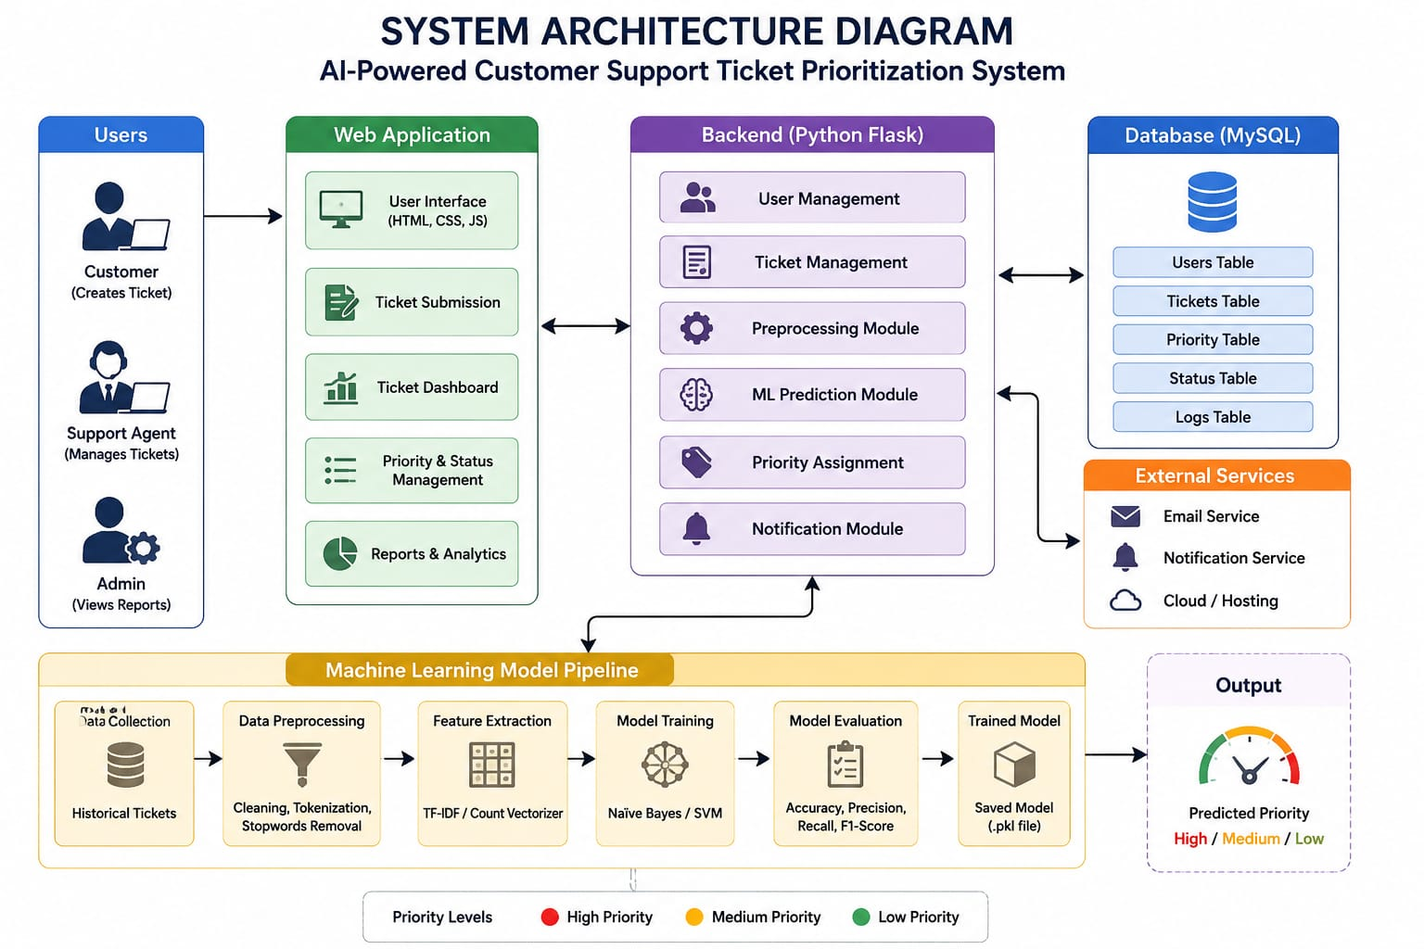
SYSTEM ARCHITECTURE

Slide 7
CONCLUSION
AI makes support systems smarter.
Faster responses improve user experience.
Easy to implement in IT companies.
Reduces workload on support staff.
Future scope: Deep Learning and Chatbot integration.

Slide 8
REFERENCES
Google Scholar research papers
IEEE Xplore Digital Library
ACM Digital Library
Scikit-learn Documentation
Python Official Documentation

